Slide 1
Adult neurogenesis and behavior
Michael A Long, PhD
Assembly and Function of Neural Circuits
March 16, 2016

Slide 2
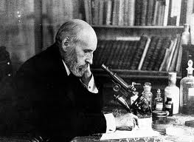
Once development has ended, the fonts of growth of the cells, axons and
dendrites dries up irrevocably. In adult centers, the nerve paths are fixed
and immutable: everything may die, nothing may be regenerated.
Santiago Ramon y Cajal

Slide 3
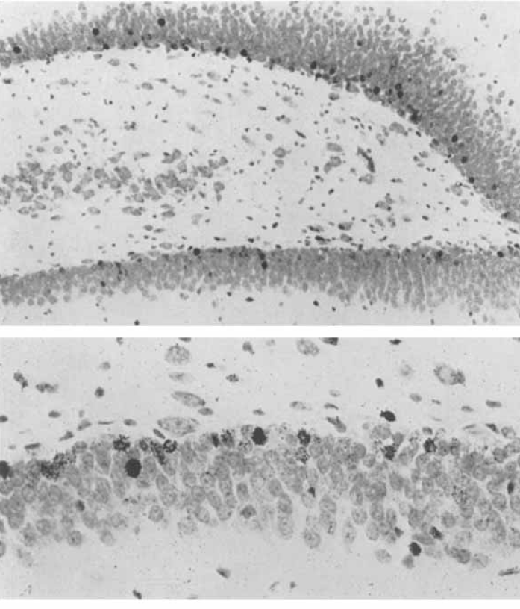
Early evidence for neurogenesis
Autoradiograms from dentate gyrus
(hippocampus) of postnatal rat
[³H]thymidine
(1950s)
Injection into the animal marks actively dividing cells by allowing for incorporation during the DNA synthesis phase of the cell cycle (S-phase). Allows for effective
birthdating, but ambiguous cell identification.
(Altman and Das, 1965)
Another early supporter: Michael Kaplan
A major dissenting voice: Pasko Rakic

Slide 4
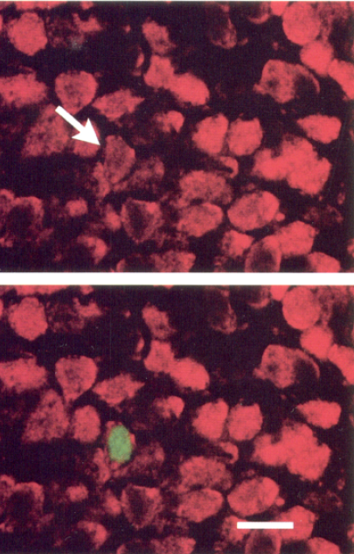
Demonstration of adult neurogenesis
Cell labeled for neuronal marker
(NeuN) as well as BrdU
Bromodeoxyuridine (BrdU)
(1990s)
Exogenous nucleotides incorporated into newly synthesized DNA. Can be easily processed for immunohistochemistry to easily determine cell identity.
(Kuhn et al., 1996)

Slide 5
How prevalent is adult neurogenesis?
→ In addition to invertebrates and a variety of other animals, adult neurogenesis has been observed in EVERY mammalian species examined, including humans (Eriksson et al.,1998) and nonhuman primates (Kornack and Rakic, 1999)
→ New neurons are generated in large numbers:
Hippocampus: 9,000 cells/day
Olfactory bulb: 30,000 cells/day

Slide 6
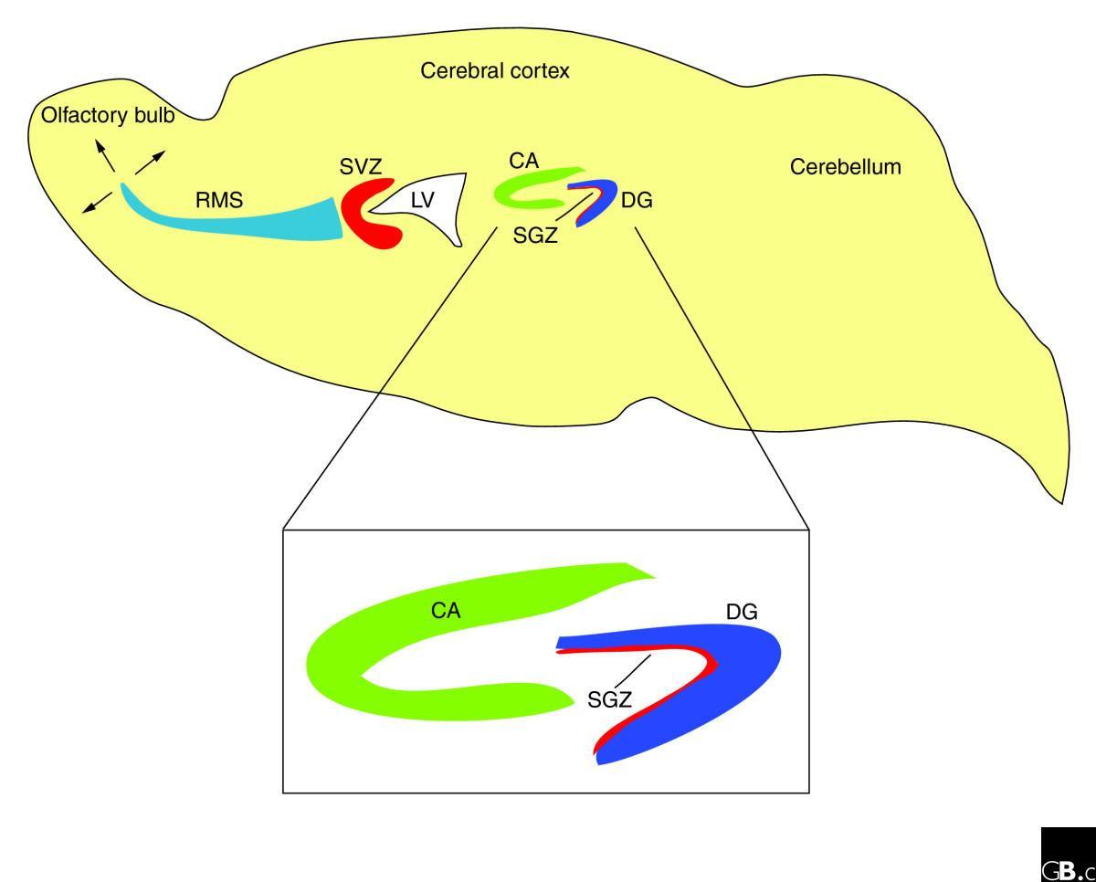
Neurogenic regions in the adult brain
subventricular zone
(to the olfactory bulb)
subgranular zone
(to the hippocampus)
(Pozniak and Pleasure, 2006)

Slide 7
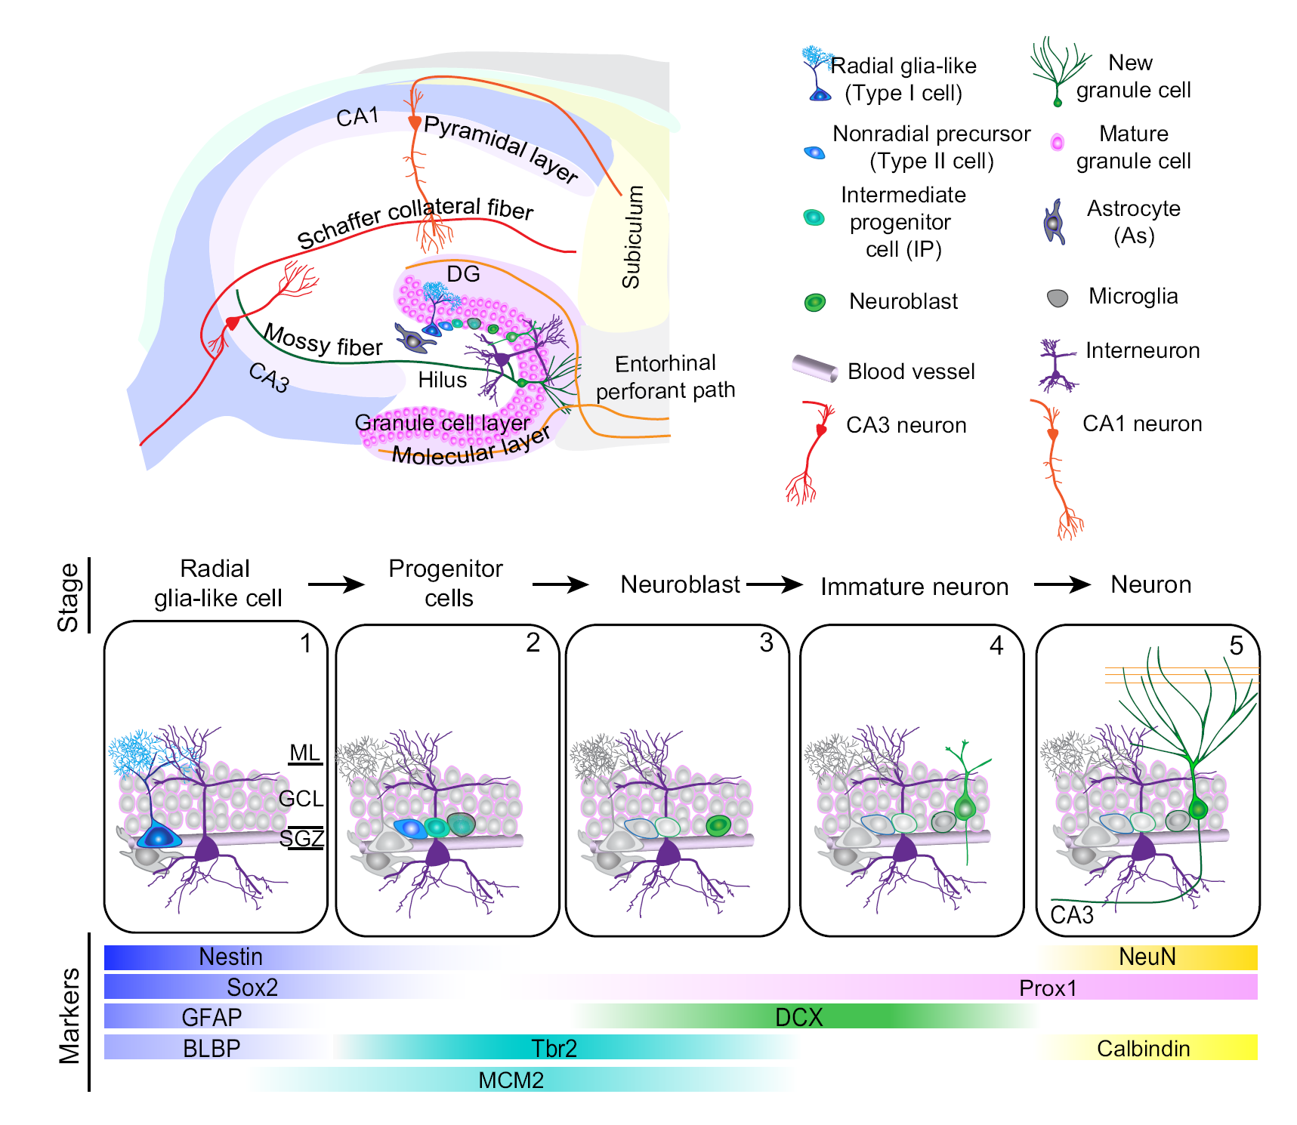
Stages of adult
hippocampal
neurogenesis
(Ming and Song, 2011)

Slide 8
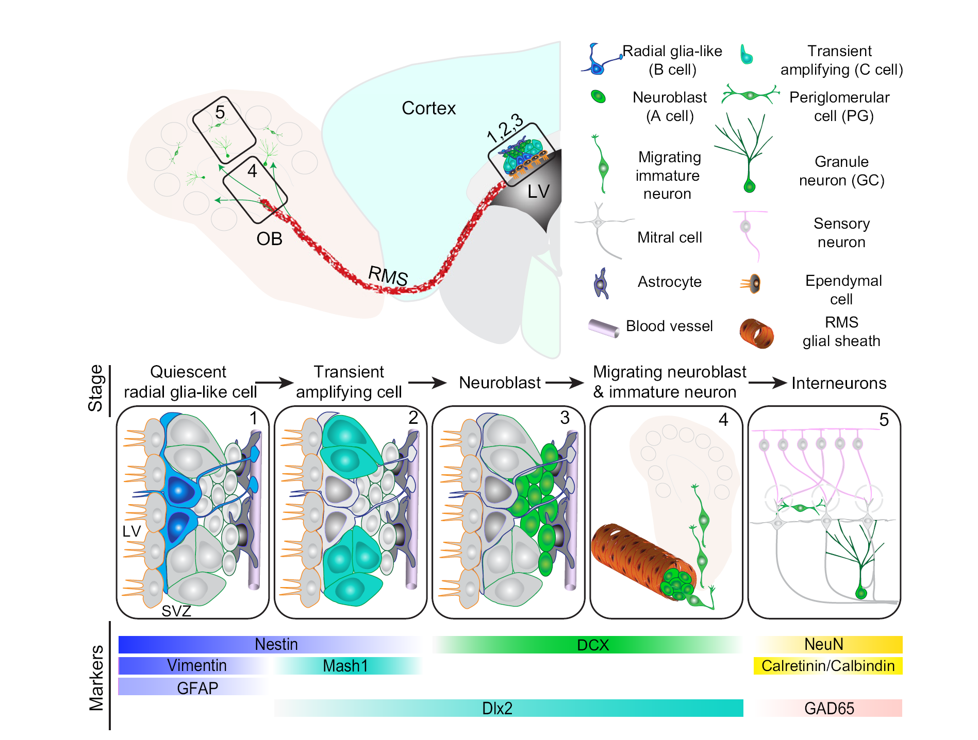
Stages of adult
subventricular zone
neurogenesis
Rostral migratory stream
(Ming and Song, 2011)

Slide 9
What is the fate of the newly born neuron?
→ In non-seasonal songbirds, neurogenesis results in a large net increase in neuron number (Walton et al., 2012) because the accumulation of new neurons is far outpacing the removal of existing cells
→ In mammals, only a fraction of new neurons survive, but this number can be regulated by various factors, such as environment, stress, exercise, learning, and neurological disease
→ The number of neurons within the olfactory bulb remains relatively constant postnatally, suggesting that new neurons may be replacing other cells within that circuit

Slide 10
Do newly born neurons functionally integrate into established circuits?

Slide 11
Visualizing/targeting new neurons in living tissue
Retroviral genetic marking
(1990s)
Viruses that lack a nuclear import mechanism and only infect the cells when the nuclear membrane breaks down during mitosis. Although this tool only infects a limited number of neurons, living cells can be labeled with a fluorescence reporter so that properties of newly born neurons can be studied in detail.
A 14 day old neuron in the premotor
cortex of a zebra finch labeled with
a Moloney Murine Leukemia Virus
(Image: Natasha Tirko)

Slide 12
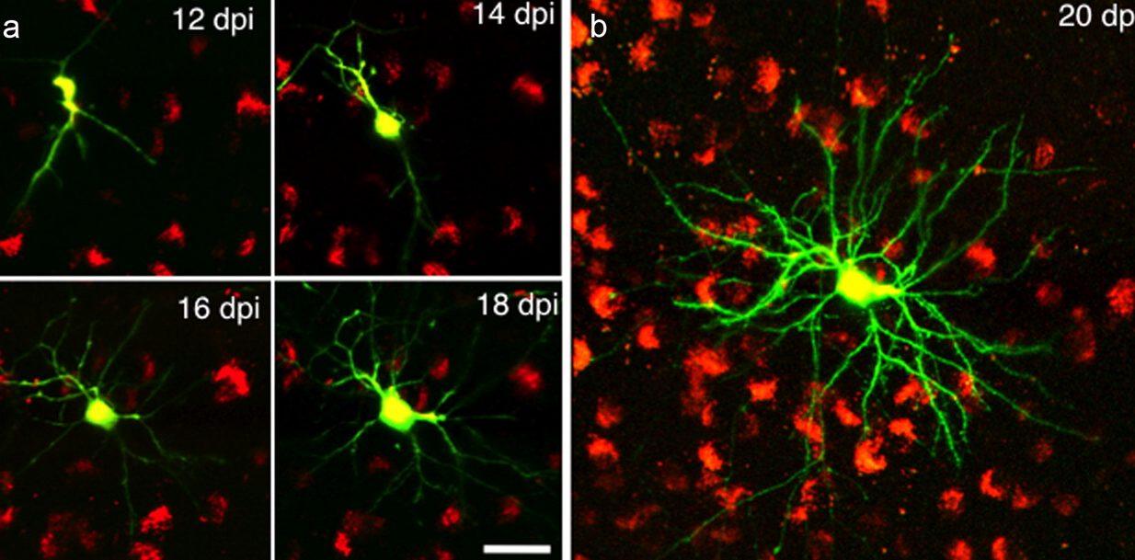
New neurons mature upon reaching their target
premotor cortex (zebra finch)
(Scott et al., 2012)

Slide 13
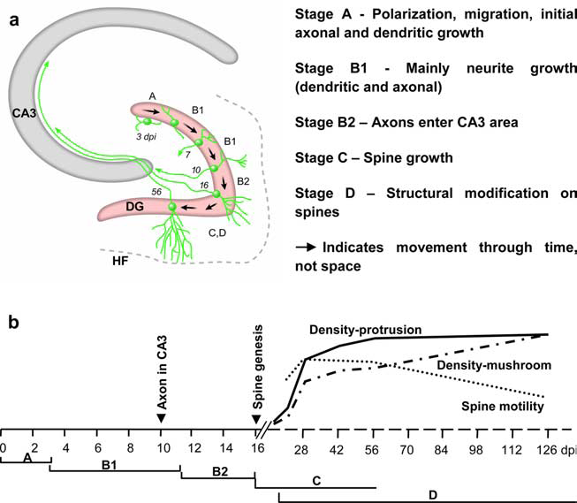
Structural maturation of a new hippocampal neuron
(Zhao et al., 2006)

Slide 14
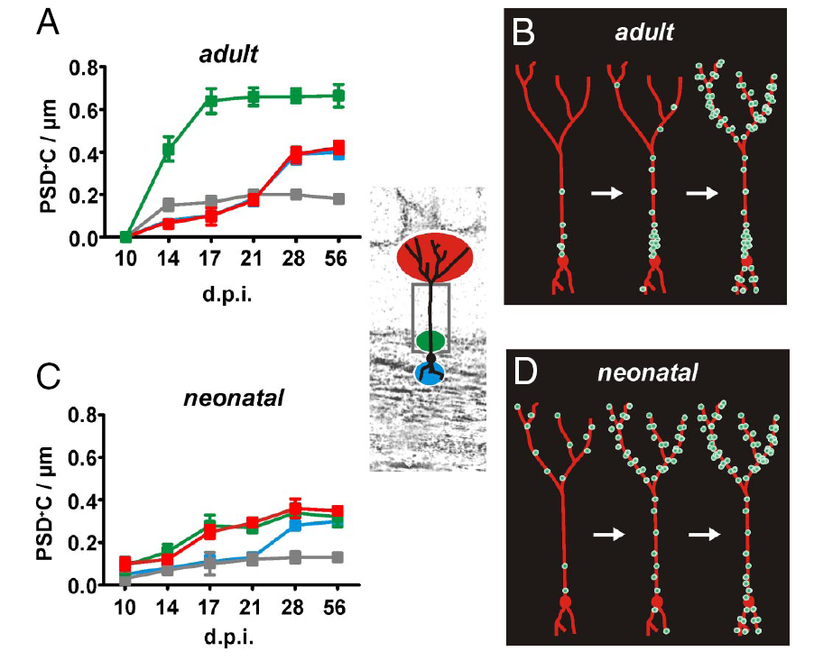
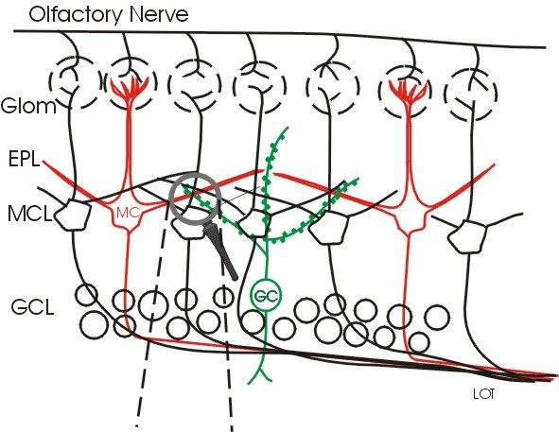
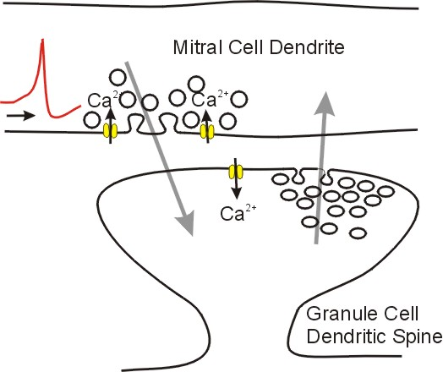
Sequential spine formation in an olfactory bulb neuron
(Kelsch et al., 2008)

Slide 15
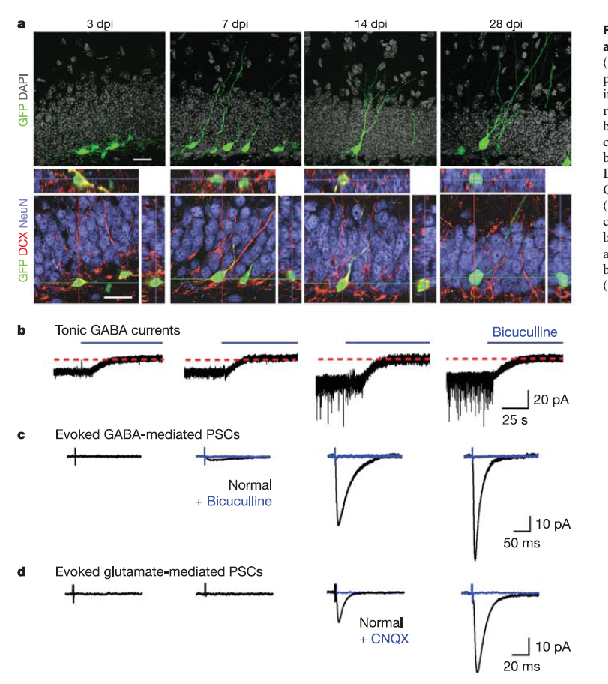
Maturation of synaptic inputs in the dentate gyrus
(Ge et al., 2006)

Slide 16
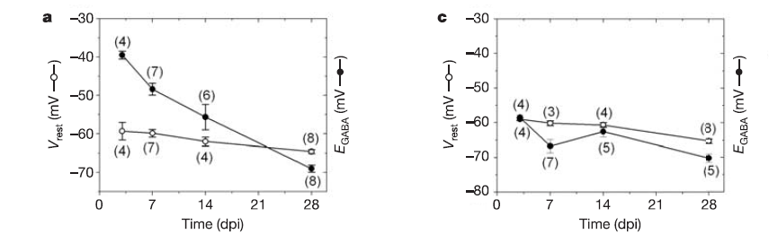
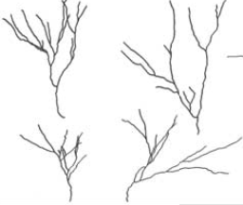
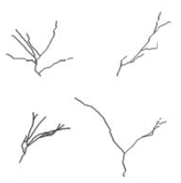
The importance of tonic GABA
GABA exerts a depolarizing action during the initial development of new DGCs due to their high [Cl2]i from the expression of NKCC1
Nkcc1-shRNA-expressing
newborn DGCs
newborn DGCs
(Ge et al., 2006)

Slide 17
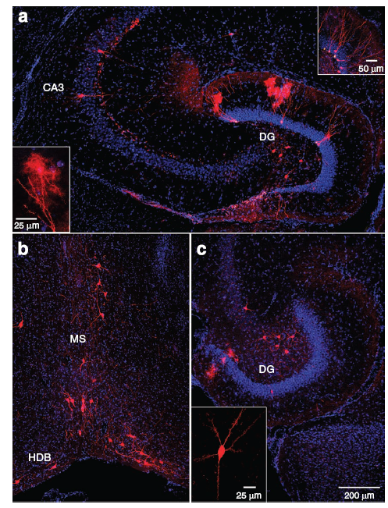
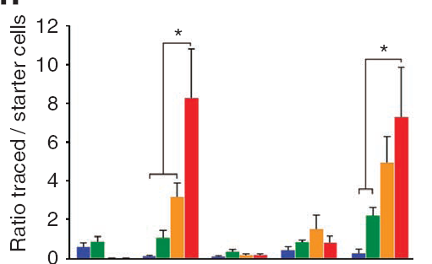
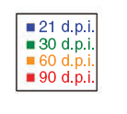
Connectivity of new neurons in hippocampus increases with time
hilar cell
cortex
granule cell
medial septum
CA3 pyramidal cell
(Vivar et al., 2012)

Slide 18
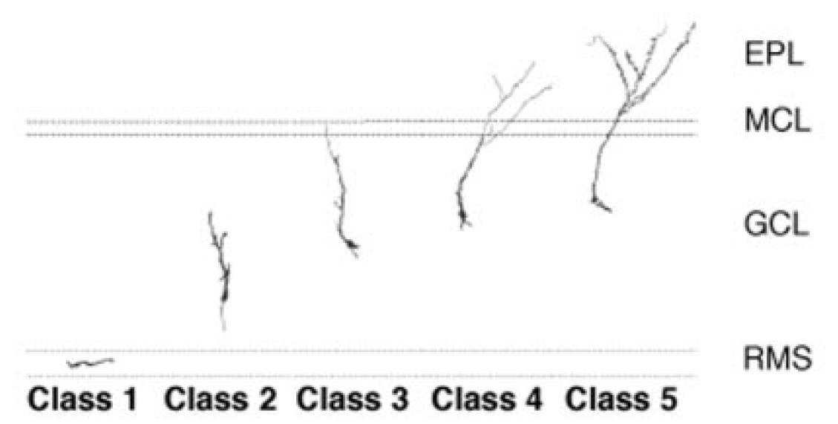
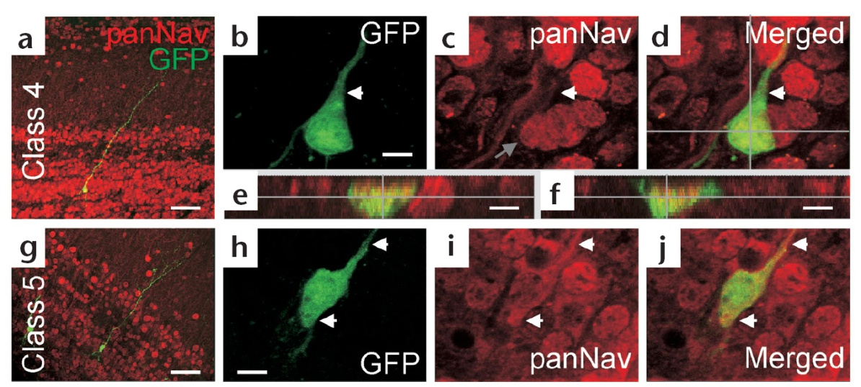
Sodium channels in newly generated olfactory neurons…
(Petraneau et al., 2002; Carleton et al., 2003)

Slide 19
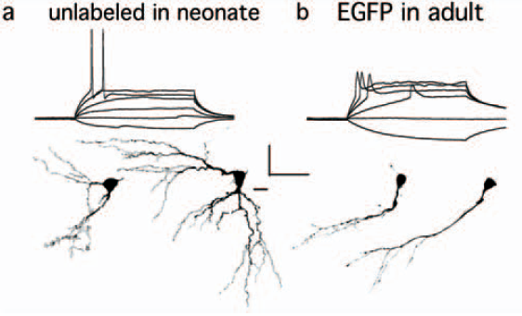
…but spiking develops relatively late
Olfactory granule cells (2 weeks postmitotic)
(Overstreet-Wadiche et al., 2006)
Zebra finch motorneuron
16 d.p.i.
Mature
(G. Kosche)

Slide 20
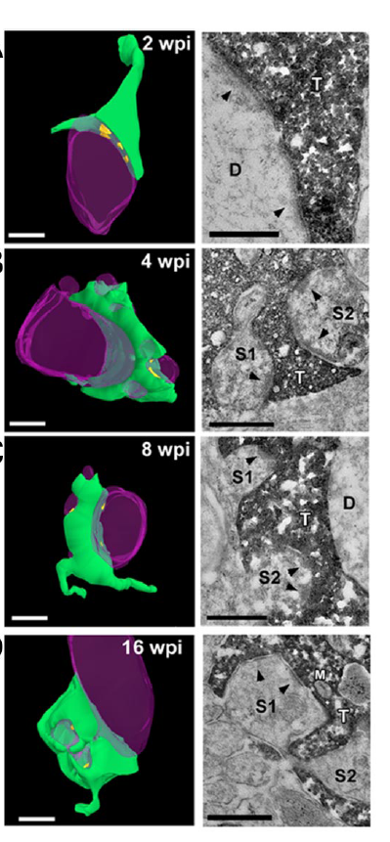
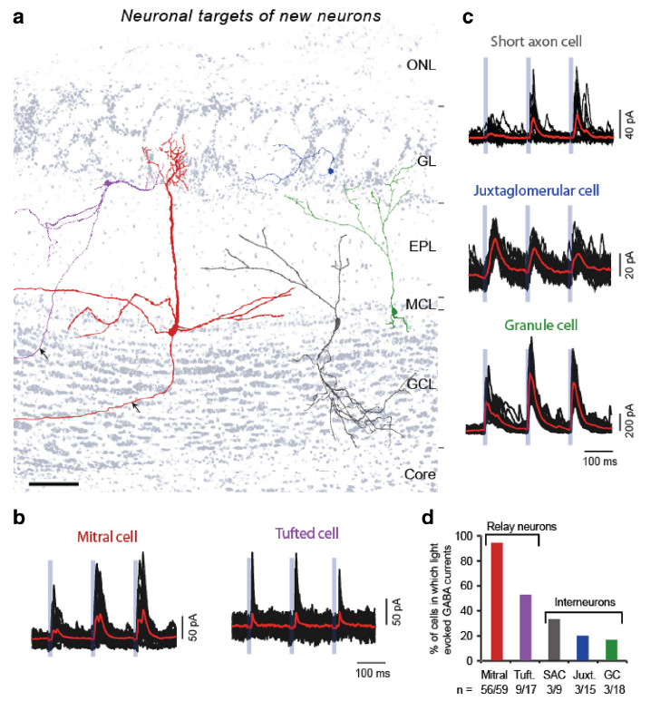
New neurons form viable synapses onto downstream neurons
DG → CA3
(synapses on spines emerge at 4 wpi)
ChR2 into newly born olfactory bulb neurons (GABAergic)
(Faulkner et al., 2008)
(Bardy et al., 2010; see also Toni et al., 2008)

Slide 21
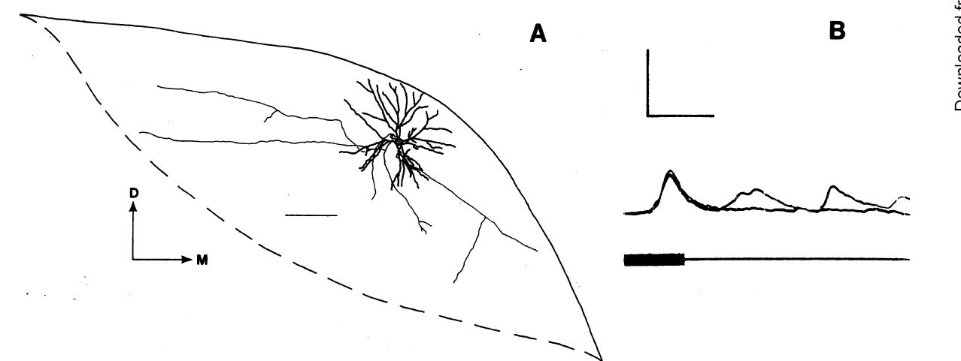
Functional incorporation of new neuron into an active circuit
Neuron in canary forebrain that was
labeled with horseradish peroxidase
(intracellular dye) and [³H]thymidine
Synaptic responses following the
Introduction of a noise burst
(Paton and Nottebohm, 1984)

Slide 22
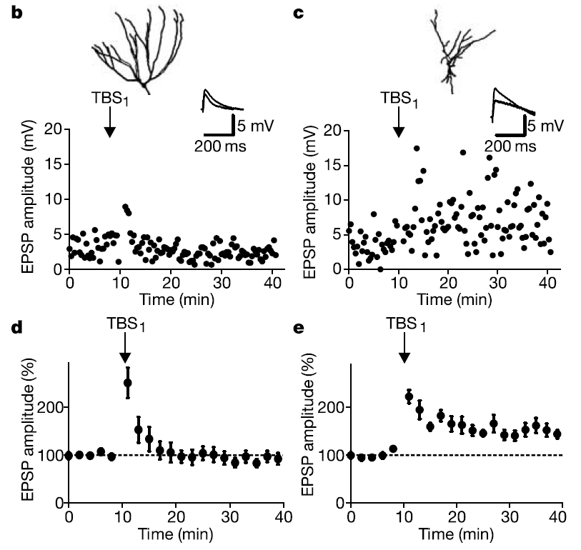
New neurons are hyperplastic
Hippocampal granule cell
Mature
Young
(Schmidt-heiber et al., 2004,
see also Wang et al., 2000)

Slide 23
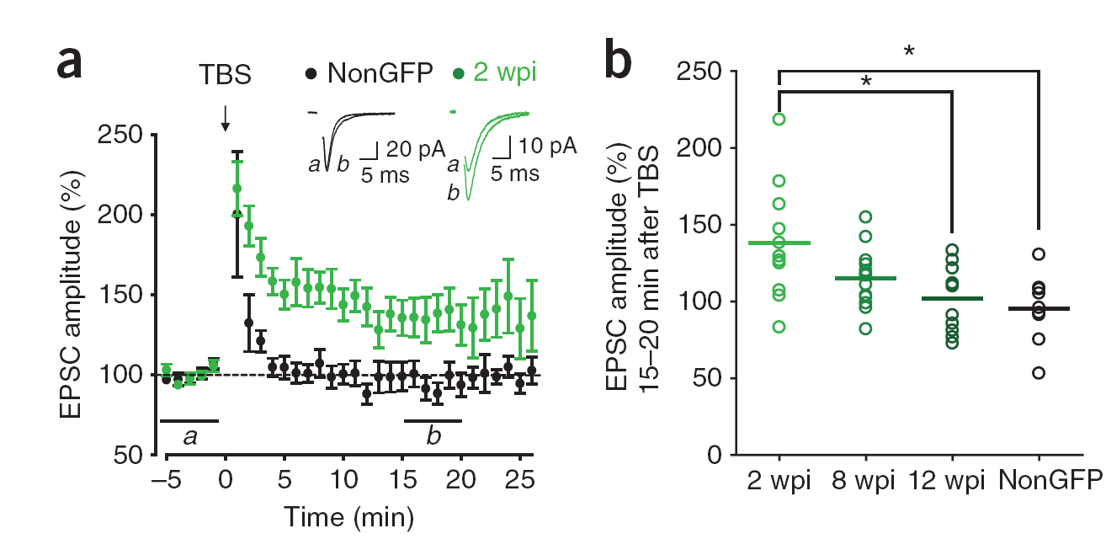
New neurons are transiently hyperplastic
Glutamatergic inputs onto olfactory bulb neurons
(Nissant et al., 2009,
for hippocampal plasticity see Ge et al.,2007)

Slide 24
What is the impact of neurogenesis on behavior?

Slide 25
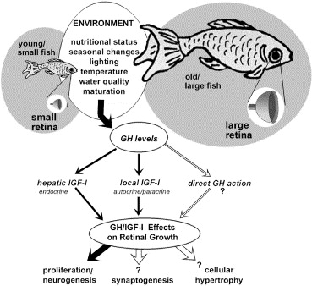
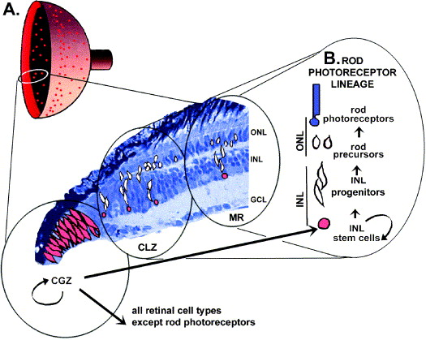
Neurogenesis allows the CNS to grow/adapt (teleost fish)
(Otteson and Hitchcock, 2003)

Slide 26
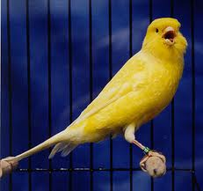
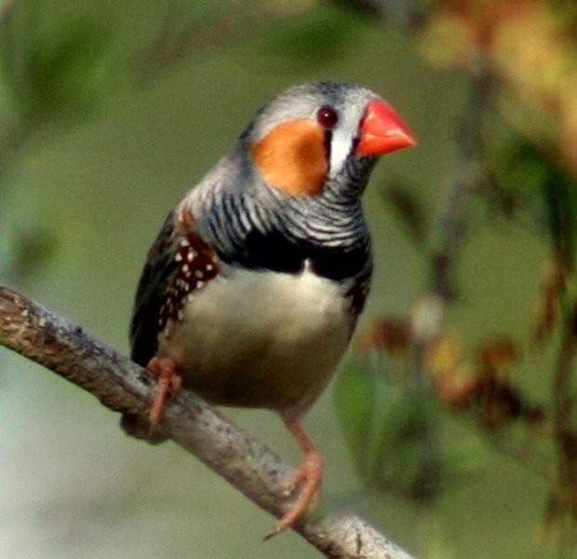
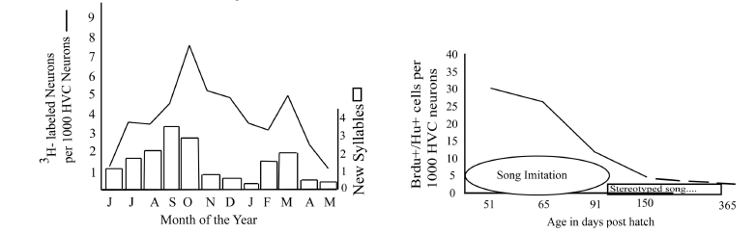
New neurons for newly relevant behavior (seasonal songbirds)
canary
zebra finch
(Kirn and Wilbrecht, 2004;
see Goldman and Nottebohm, 1983)

Slide 27
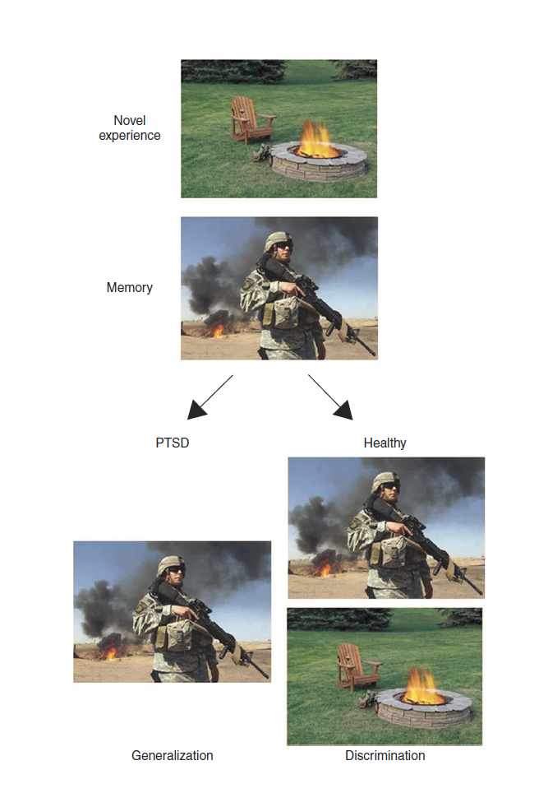
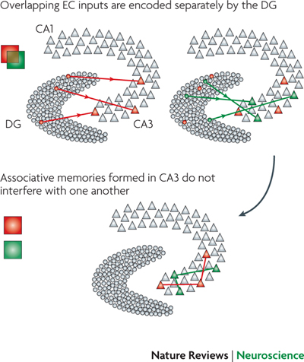
Adult-born granule cells in hippocampus
Dentate gyrus, pattern separation and anxiety

Slide 28
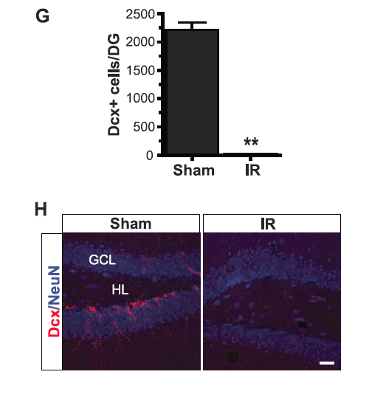
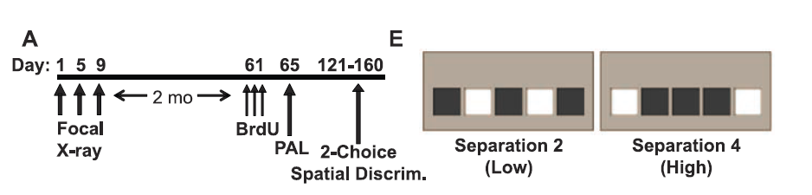
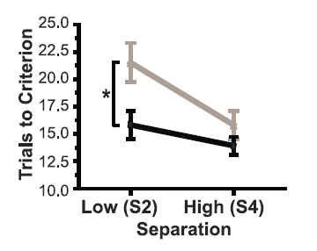

Adult-born granule cells in hippocampus
Ablating new neurons leads to deficits in pattern separation
(Clelland et al., 2009)

Slide 29
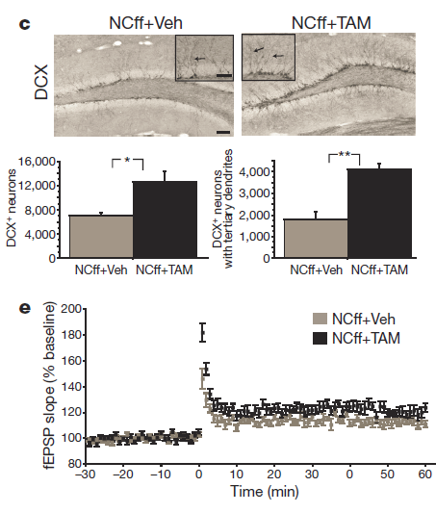
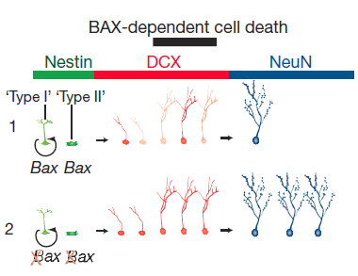
Adult-born granule cells in hippocampus
Increasing new neurons by ablating Bax
(Sahay et al., 2011)

Slide 30
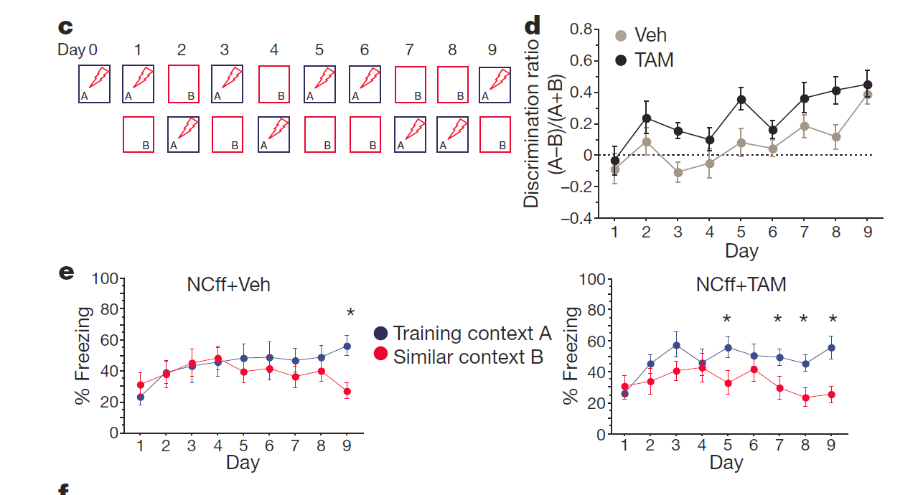
Adult-born granule cells in hippocampus
Increasing numbers of new neurons leads to improved pattern separation
(Sahay et al., 2011)

Slide 31
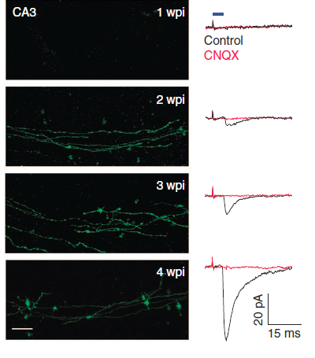
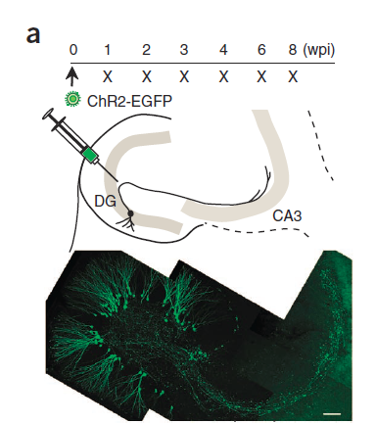
Adult-born granule cells in hippocampus
Increasing impact of newly born neurons on CA3
(Gu et al., 2012)

Slide 32
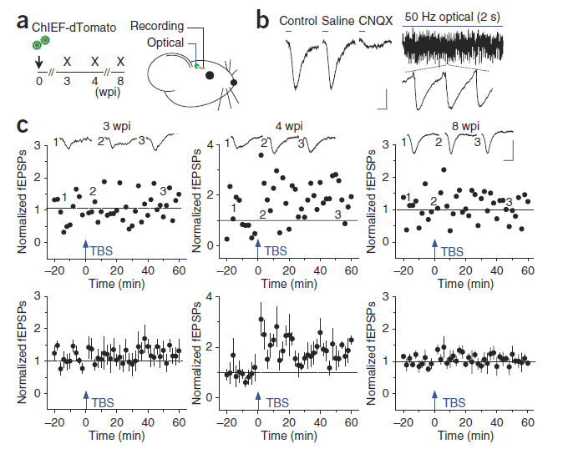
Adult-born granule cells in hippocampus
Transient hyperplasticity of DG-CA3 synapse
(Gu et al., 2012)

Slide 33
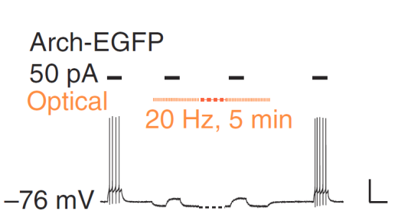
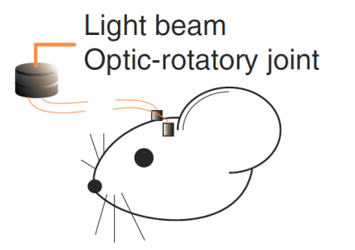
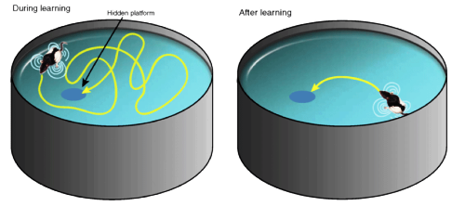
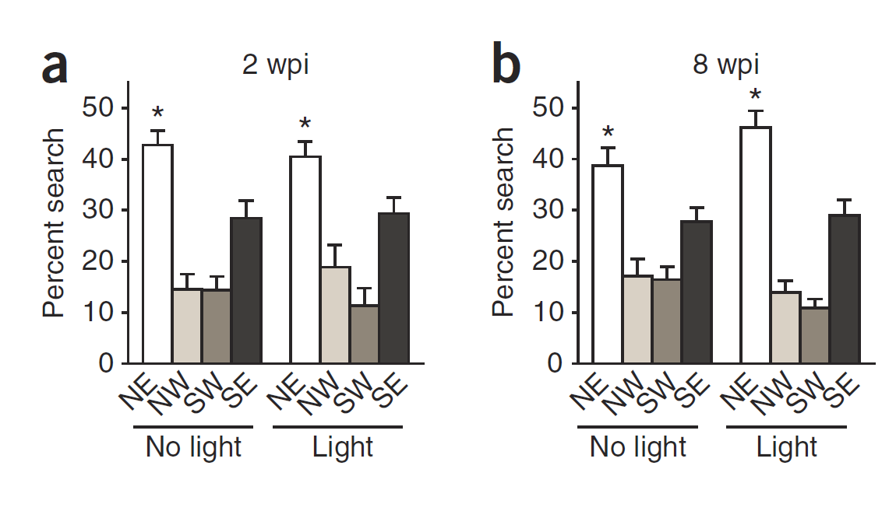
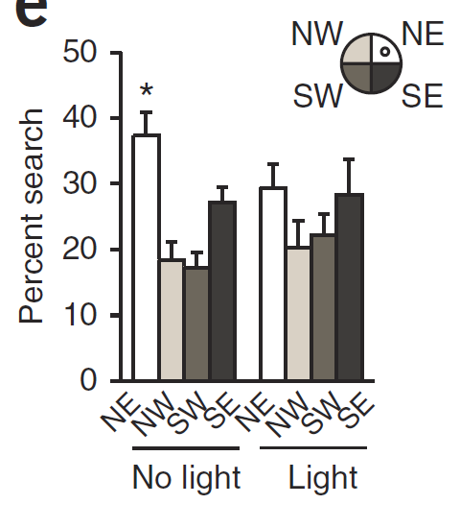
Adult-born granule cells in hippocampus
Transient window for behavioral responses
Morris Water Maze
4 wpi
(Gu et al., 2012)

Slide 34
